Slide 1
Predicting Customer Churn for a Music Streaming App
Providing Predictive Models and Data Insights to Aide in Targeted Marketing and Improve Customer Retention

Slide 2
Background: Business Problem
For a subscription based business, customer churn refers to customers canceling their service
The churn rate must be lower than the new subscriber rate for the company to grow
Accurately predicting customer churn is critical for business projections and long term success
Segmenting customers who have a high churn probability is very valuable to the marketing team to deploy targeted efforts to increase customer retention

Slide 3

Hypothetical Client
KKbox is the biggest music streaming service in East Asia with a large library of Asian pop music
Users can stream unlimited numbers of songs from their smartphones or other devices in exchange for a monthly fee
Basically, it's Taiwanese Spotify

Slide 4
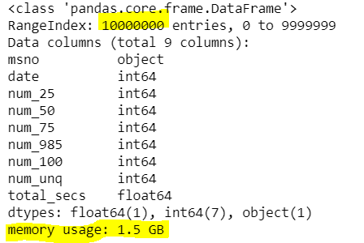
Data
Kaggle provided their anonymized user data on the competition page.
There were 4 different types of csv data tables: train/test, members, transactions, and user logs
One column they all have in common is User ID (MSNO)
Train/test and members files are indexed by User ID, while transactions and user logs are indexed by date
Transactions file contain ~ 20 million records (@1.61 GB) and user logs file contains ~ 200 million (@ 22.4 GB) records
This presents a challenge as most any laptop/desktop does not have enough RAM to hold these files in memory if using python packages such as Pandas taught in this course

Slide 5
Data Description (columns)
Train/test
User ID
Churn (0 or 1)
Members
User ID
Age
Gender
Registration method
Registration Date
Transactions
Date
User ID
Payment method
Days in pay period
Payment plan list price
Actual amount payed
Auto renew (0 or 1)
Membership expire date
Cancellation (0 or 1)
User Logs
Date
User ID
# of Songs played to 0-25%
# of Songs played to 25-50%
# of Songs played to 50-75%
# of Songs played to 75-98.5%
# of Songs played to 100%
# of unique songs played
Total seconds played

Slide 6
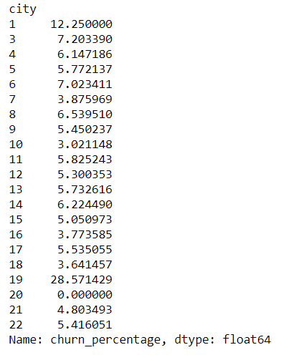
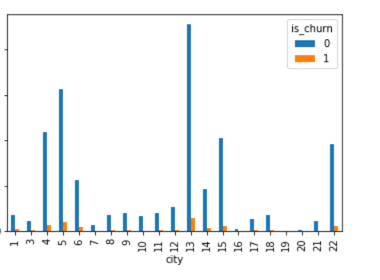
Exploratory Data Analysis

Slide 7
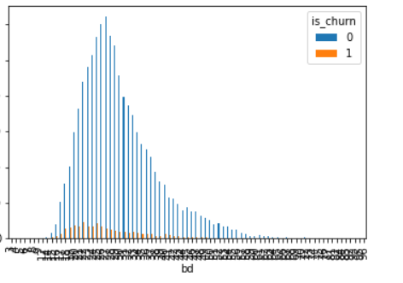
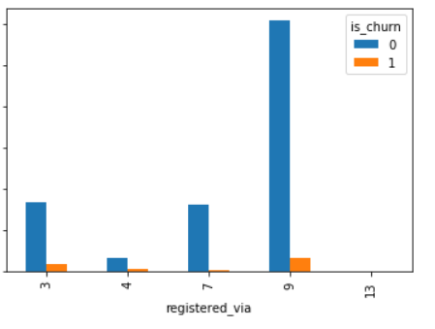
EDA con’td

Slide 8
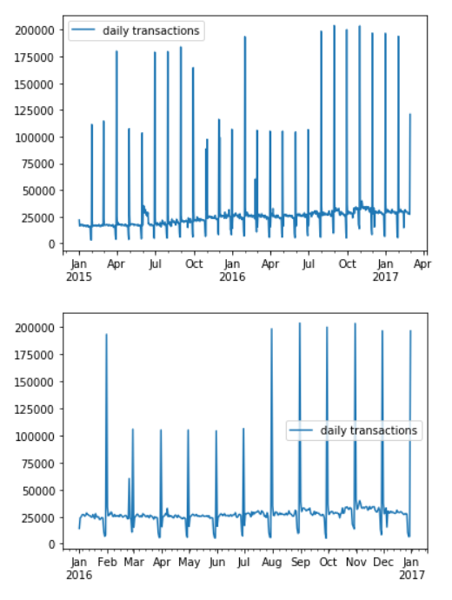
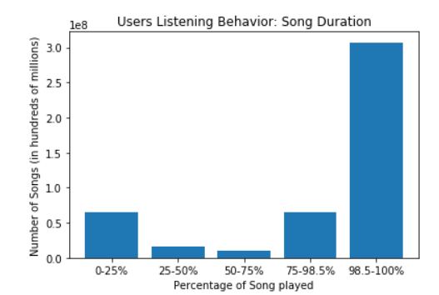
EDA con’td

Slide 9
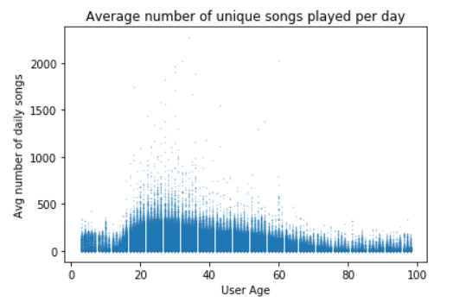
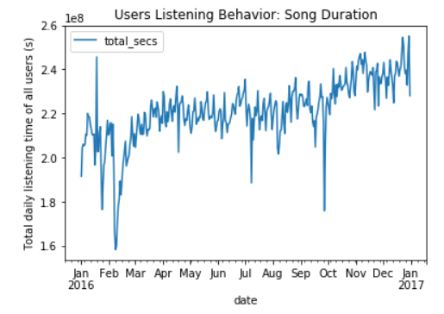
EDA con’td

Slide 10
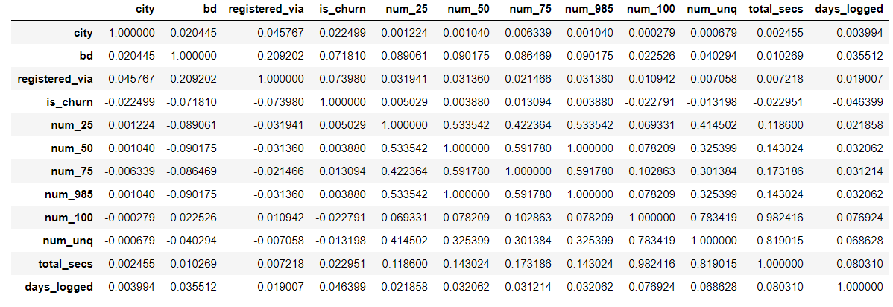
Correlation Matrix (Pearson R)

Slide 11
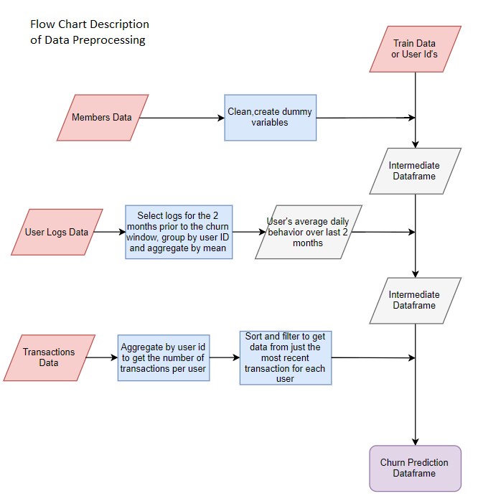
Data Wrangling

Slide 12
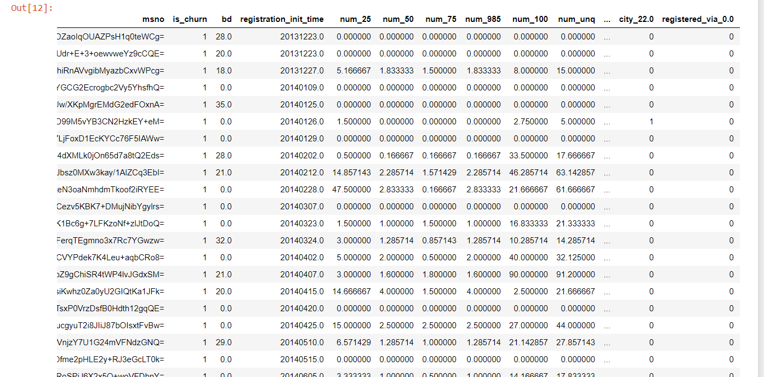
Data Wrangling

Slide 13
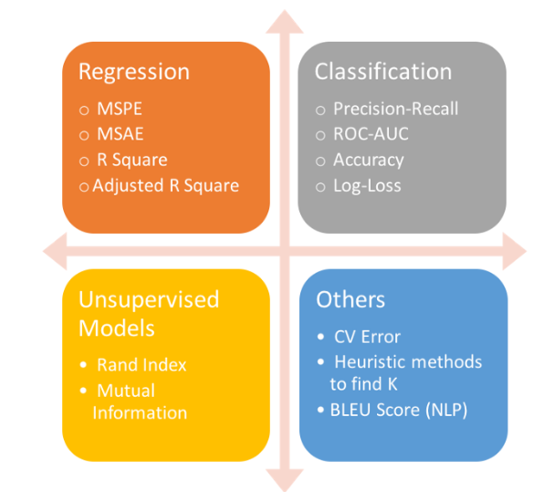
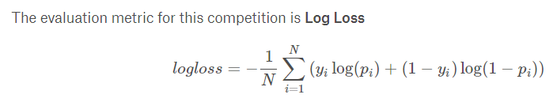
Model Selection
Log loss of random guessing = ln(0.5) = 0.693
Log loss of hypothetical perfect model = 0.0

Slide 14
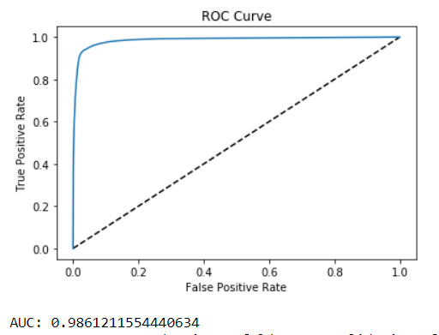

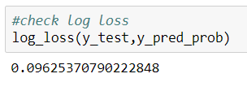

Model Performance: Random Forest
Confusion Matrix
Evaluation Set:
Competition
Scoring:

Slide 15
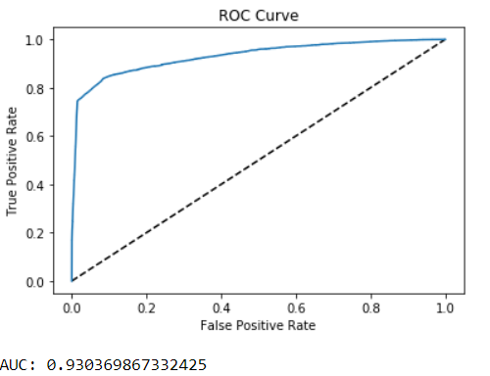

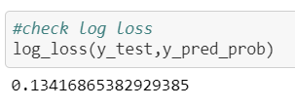

Model Performance: Logistic Regression with Grid Search Hyperparameter Optimization
Confusion Matrix
Evaluation Set:
Competition
Scoring:

Slide 16

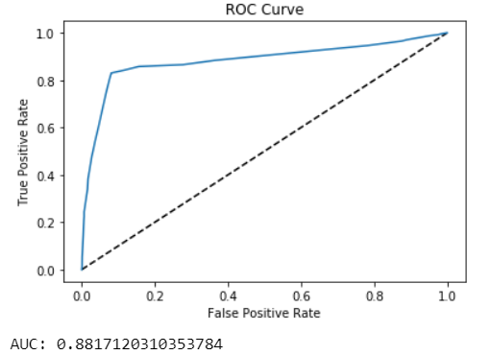
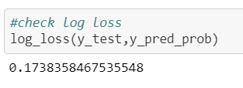

Model Performance: Logistic Regression- ridge regression penalty with LASSO regression selected features (final model)
Confusion Matrix
Evaluation Set:
Competition
Scoring:

Slide 17
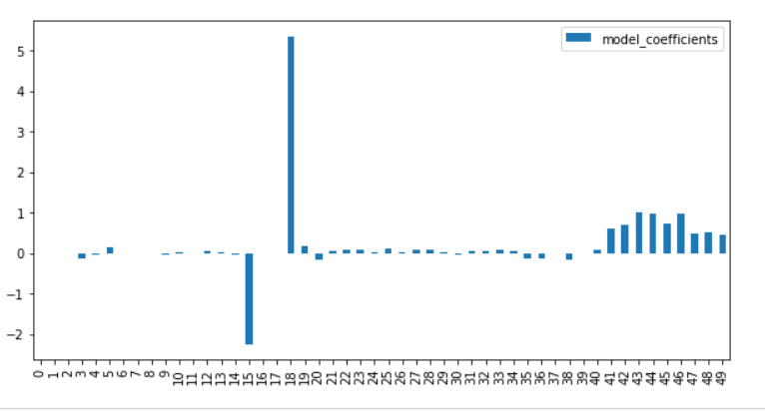
Features: LASSO Regression with All Features
Coefficient Value
Feature

Slide 18
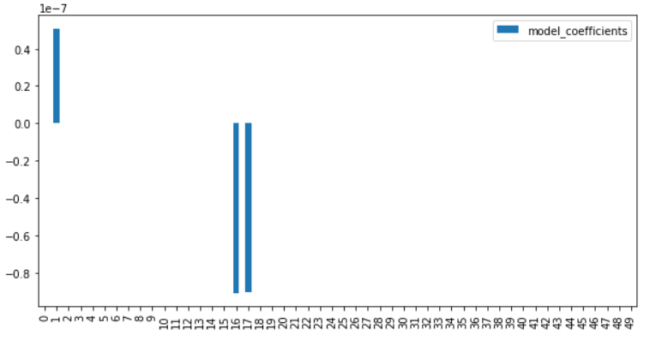
Features: Ridge Regression with All Features
Coefficient Value
Feature

Slide 19
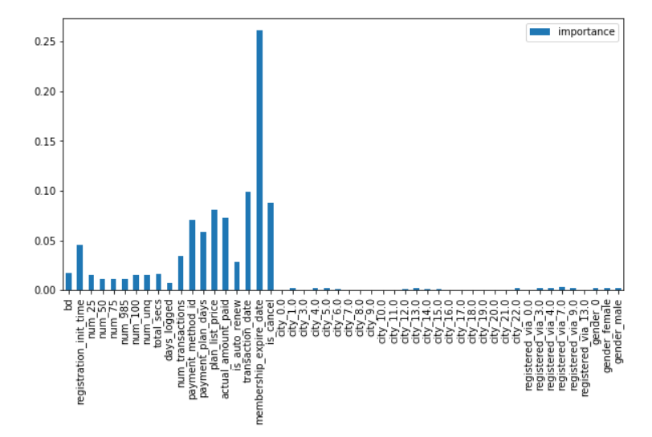
Random Forest Feature Importance

Slide 20
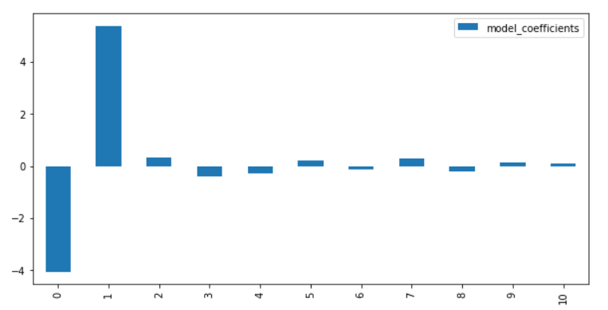
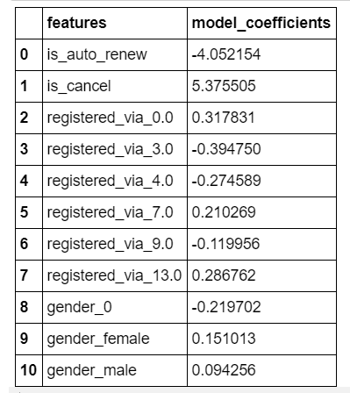
Final Model Feature Coefficients

Slide 21
Recommendation to Client:
Apply targeting marketing strategies to customers with high churn probability
Consider features of users that have significance to churning when implementing product improvements

